Slide 1

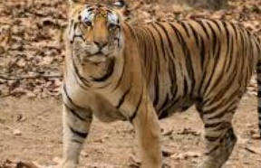
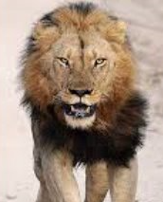
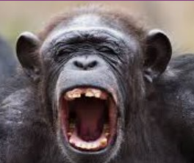
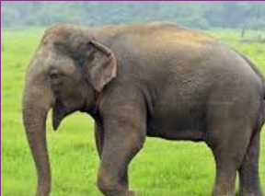
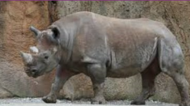
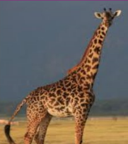
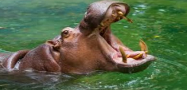
Year 1: Animals Knowledge Mat
Subject Specific Vocabulary |  | Interesting Book | Sticky Knowledge about animals
fish | A fish is a scaly skinned creature with a spine that swims in water and breathes using gills.
 |  |  | The blue whale can produce the loudest sound of any animal.
amphibians | All amphibians begin their life in water with gills and tails. Examples are frogs and newts.
 |  |  | Horses and cows sleep while standing up.
reptiles | Are animals that are cold-blooded. Most lay eggs and their skin is covered with hard, dry scales
 |  |  | Giant Arctic jellyfish have tentacles that can reach over 36 metres in length.
birds | Birds have feathers and wings. They lay eggs and are warm-blooded animals.
 |  | Wild Animals | Tigers can grow up to a length of 3 metres and weigh up to 300 kilograms when fully developed.
mammals | Mammals are also warm blooded animals. They breath air and have a backbone.
 |  |  | There are about 400 million+ dogs in the entire world. The average life of a dog depending on the breed can vary from 10 to 14 years.
carnivore | A carnivore is a meat-eating animal that gets its food from killing other animals.
herbivore | A herbivore does not eat food and they eat plants. |  | Dolphins use whistling, clicking and other sounds to communicate with each other.
omnivore | An omnivore eats plants and meat.
 |  |  | Camels can survive up to six months without water or food due to the fatty tissues stored in their humps.
tame | Domesticated animals that are not dangerous to or frightened of humans.
wild | Living in the natural environment and not belonging to humans. |  | The cheetah is the fastest animal to roam the earth with top speeds of 113 km per hour.
nocturnal | Animals that tend to be awake during the night time.

