Slide 1

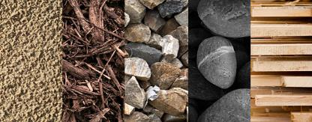
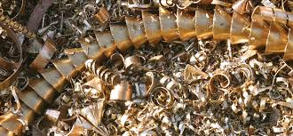
Year 1: Materials Knowledge Mat
Subject Specific Vocabulary |  | Materials for clothes |  | Uses of materials
materials | Is what something is made of, e.g. wood or plastic. | 1 | Leather – used for shoes, jackets and trousers | 1 | Glass
wood | The material that comes from a tree. It varies in hardness. |  |  | Windows in houses and cars to see through. Mirrors – to see yourself – reflection.
 |  | 2 | Wool – used for jumpers, socks, pyjamas and coats
plastic | A ‘man-made’ material that can be shaped or moulded to any shape.
 |  | 3 | Cotton – used for clothes we wear on warmer days and shirts.
metal | A tough and strong material which can be heated and shaped into anything. |  |  | 2 | Metal
 |  | 4 | Silk – expensive materials used for scarves, blouses | Strength – used in construction of planes, cars and trains.
liquid | Liquids can flow and take on the shape of their container.
gas | We can’t see gas but it is all around us. There are different types of gas.
 |  |  |  | 3 | Wood
stretch | A stretchy material is one that is like elastic. |  |  | Doors – most doors are made from wood. Furniture – most furniture is made of wood, often special wood.
stiff | A stiff material is firm and hard and not flexible.
bend | A bendy material is one that can be twisted and is flexible.
 |  |  |  | 4 | Plastic
waterproof | Is a material that does not allow water or liquid through.
 |  |  |  | Moulded or shaped to form any shape from buckets to animal jelly casts.
shiny | A shiny material is sparkly or glossy and sometimes glittery.

