Slide 1
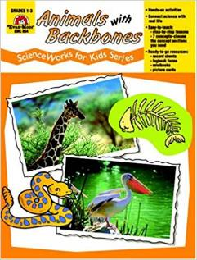

Year 6: Animal Classification Knowledge Mat
Subject Specific Vocabulary |  | Interesting Books | Sticky Knowledge about Classification of animals
micro-organism | Micro-organisms are tiny. They are so small they can only be seen with a microscope.
 |  |  | The largest vertebrate is the blue whale, which can grow to over 100 feet long and 400,000 pounds.
vertebrates | A vertebrate animal is one that has a backbone.
invertebrates | An Invertebrate animal does not have a backbone and 97% of creatures belong to this group. |  | The smallest vertebrate is thought to be a tiny frog called the Paedophryne amauensis. It only grows to about 0.3 inches long.
species | This is the grouping together of similar species of plant, animal and other organisms.
 |  |  | Vertebrates tend to be much more intelligent than invertebrates.
fungi | Fungi are a group of living organisms which are classified in their own kingdom. This means they are not animals, plants, or bacteria.
 |  |  | Vertebrate animals can be either warm or cold-blooded. A cold-blooded animal cannot maintain a constant body temperature. The temperature of their body is determined by the outside surroundings.
monera | The whole organism is made up of just one cell. The cell is more basic than cells of other organisms.
 |  | Important facts to know by the end of the classification of animals topic:
bacteria | Bacteria are tiny little organisms that are everywhere around us. |  | An invertebrate is an animal that does not have a backbone. 97% of all animal species are invertebrates.
 |  | Be able to classify living things into broad groups according to observable characteristics and based on similarities and differences. know how living things have been classified. give reasons for classifying plants and animals based on specific characteristics.
protista | Protists are not animals, plants, fungi, or bacteria. Many protists are so small that people can see them only through a microscope.
 |  |  | Frogs can breathe through their skin.
algae | Is a single or multi-cellular organism that has no roots, stems or leaves and is often found in water.
 |  |  | There are a wide variety of interesting ocean animals that are invertebrates. These include sponges, corals, jellyfish, anemones, and starfish.
Carl Linnaeus | Carl Linnaeus is famous for his work in Taxonomy, the science of identifying, naming and classifying organisms (plants, animals, bacteria, fungi, etc.).

